Slide 1




Windows System Administration
Telerik Software Academy
academy.telerik.com
Group Policy
Borislav Varadinov
Policy
Object
Template
System Administrator
bobi@itp.bg
Computer Configuration
User Configuration

Slide 2

Table of Contents
What is a Group Policy?
Common Group Policy Scenarios
Example of Group Policy Settings
Local Group Policy
User and Computer Configuration
GPO Precedence
Group Policy Management Console
Group Policy Results and Modeling
Group Policy Tools

Slide 3

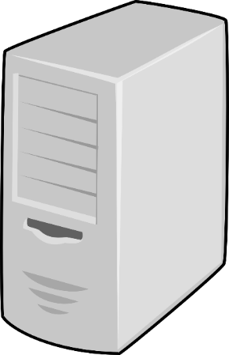
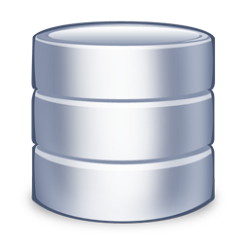
What Is Group Policy?
Policy
Policy
Policy
AD DB
Manage user and computer environments
Enforce IT policies
Simplify administrative tasks
Implement security settings

Slide 4
Common Group Policy Scenarios
Desktop Scenario
Workstations
Multiuser workstation
Mobile Laptops
Public Computer
Kiosk
Server Scenarios
Common IT and Security policies
Web Farms
Remote Desktop Services Farms

Slide 5
Example of Group Policy Settings
Security Settings
Account Policies
Local Policies
Firewall
Configuration Settings
Desktop Screensaver
IE default page
Software Deployment Settings

Slide 6
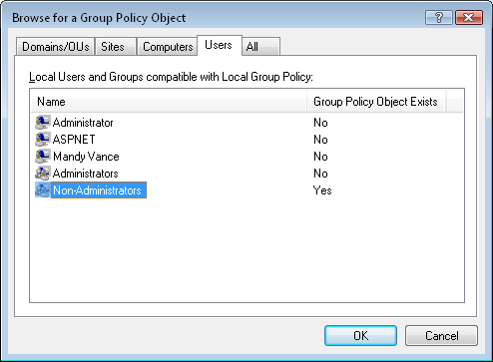
Local Group Policy
Selecting the Non-Administrators LGPO in the Browse for a Group Policy Object dialog box

Slide 7



Group Policy Objects and Templates
AD Object
File
Template
Policy
Object
Template
Policy
Object
User Configuration
Computer Configuration
Computer Configuration
User Configuration
Domain
Sysvol

Slide 8

Link Group Policy Scope
Policy
Domain
Site
OU

Slide 9
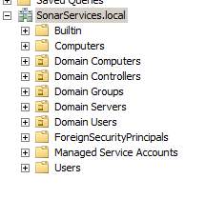

User and Computer Configuration
Policy
Policy

Slide 10

GPO Precedence
Local Security Policy
Site Policy
Domain Policy
Parent OU Policy
Child OU Policy

Slide 11
GPO Precedence (cont.)
GPO application order and scope can be affected by the following:
Filtering by using security groups
Blocking Group Policy inheritance
Enforcing a GPO link
Disabling a GPO link
Windows Management Instrumentation filters (WMI filters)

Slide 12
When is Group Policy Applied?
Startup and Shutdown
Logon and Logoff
Defined intervals
Forced with GPUpdate tool

Slide 13
Group Policy Management Console
MMC snap-in
Easy management
Reporting and modeling
Includes Group Policy Object Editor

Slide 14
Group Policy Results and Modeling
Group Policy Results
Reports actual policy settings
Group Policy Modeling
Simulates GPOs on user or computer

Slide 15
Using Gpupdate
Gpupdate is a command-line tool used to update Group Policy settings on Active Directory objects before the normal update process takes place.
gpupdate [/target:{computer|user}] [/force] [/wait:value] [/logoff] [/boot]

Slide 16
Other Group Policy Tools
Gpresult
Command-line tool that provide details for applied group policies and settings
RSOP.msc
MMC tool that provide details for applied settings

Slide 17
Group Policy
http://academy.telerik.com

Slide 18
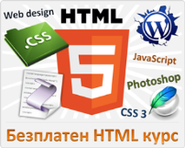



Free Trainings @ Telerik Academy
"Web Design with HTML 5, CSS 3 and JavaScript" course @ Telerik Academy
html5course.telerik.com
Telerik Software Academy
academy.telerik.com
Telerik Academy @ Facebook
facebook.com/TelerikAcademy
Telerik Software Academy Forums
forums.academy.telerik.com

